Slide 1
DENSITY BASED TRAFFIC LIGHT CONTROL SYSTEM
By Team member-
Paras Jain
Gagan Dhami
Adesh Singh
Abhishek Pandey
3rd year CSE
MGM COLLEGE OF ENGINEERING AND TECHNOLOGY COET, NOIDA

Slide 2
Contents
PROJECT OVERVIEW
Introduction
Scope and Objective
Features of the System
PROJECT Idea
Methodology
Project Details
PROJECT DESIGN
Traffic Junction
Circuit Diagram
Work Flow Diagram
PROJECT Requirements
Hardware
Software
CONCLUSION
Project Conclusion
BIBILIOGRAPHY
References

Slide 3
Introduction
In modern life, we have to face with many problems one of which is traffic congestion becoming more serious day after day. The major cause leading to traffic congestion is the high number of vehicles which were caused by the population and the development of the economy. Due to the massive growth in urbanization and traffic congestion, an automatically based traffic light controller is needed to reduce the traffic delay and travel time, especially in developing countries. Traffic congestion is now considered to be one of the biggest problems in urban areas. Traffic problems will be also much more widely increasing as an expected result of the growing number of transportation means and the current low-quality infrastructure of the roads. This idea of controlling the traffic light efficiently in real-time.

Slide 4
Scope and Objective

Slide 5
Features of the system:
Traffic flow GUI.
Signal light timings for each road.
Manual override for particular sides.
Dynamic Traffic density input module.
Dynamic signal scheduling functionality.
Traffic scheduling algorithm implementation.

Slide 6
METHODOLOGY
The system is based on Arduino.
The system contains piezo electric sensor which are mounted on the roads.
This sensor system gets activated when any vehicle passes on road over sensor.
The microcontroller controls the sensor system and gets activated when vehicles are passing over the sensors.
Based on different densities of vehicles, the microcontroller decides the glowing time of the traffic lights.

Slide 7
Project Details
This innovative software projects is an effective traffic signal management project that allows for managing 4 way traffic signal management system. The system consists of 4 signals corresponding to each road. We here propose a density based traffic signal scheduling algorithm. The system is designed to manage traffic signal timings based on the density of traffic on its corresponding road. The system represents the traffic strength of a road graphically using traffic judgments. By measuring the traffic lined up on a particular road the signal timings are adjusted to let that particular way clear out and then the next populated one. The entire system works according to an algorithm that allows for smooth and efficient traffic flow across all four ways. It also consists of an emergency override that allows traffic authorities to remotely let go a particular signal in case an ambulance or important vehicle arrives on that way.

Slide 8
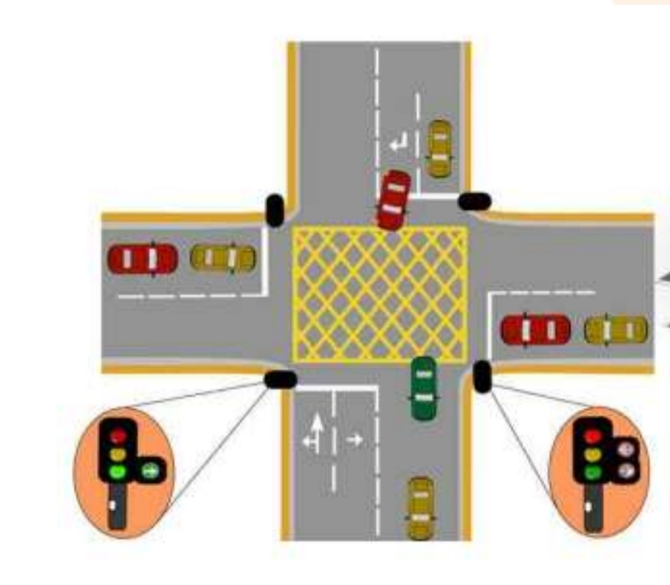
Traffic Junction

Slide 9
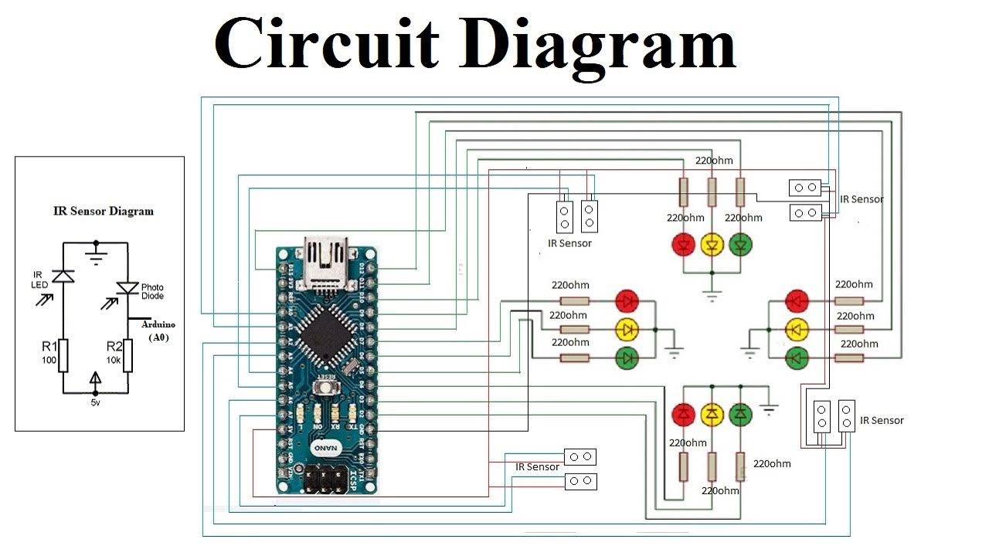

Slide 10
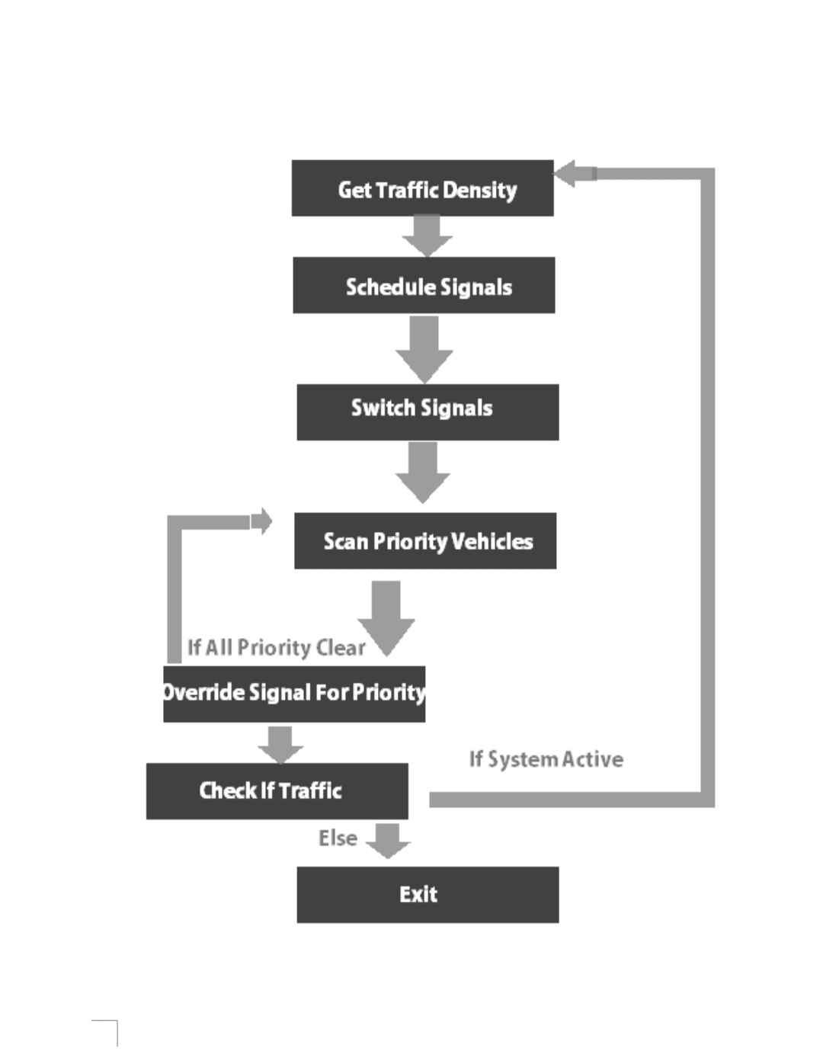
WORK FLOW

Slide 11
Hardware Requirements :-
Arduino Nano- Arduino is an open-source project that created microcontroller based kits for building digital devices and interactive objects that can sense and control physical devices.
The project is based on microcontroller board designs, produced by several vendors, using various microcontrollers. These systems provide sets of digital and
analog input/output (I/O) pins that can interface to various expansion boards (termed shields) and other circuits.
The boards feature serial communication interfaces, including Universal Serial Bus (USB) on some models.
For programming the microcontrollers, the Arduino project provides an integrated development environment (IDE) based on a programming language named Processing which also
supports the languages C and C++.

Slide 12
LED
A light-emitting diode (LED) is a two-lead semiconductor light source .It is a p–n junction diode, which emits light when activated. When a suitable voltage is applied to the leads, electrons are able to recombine with electron holes within the device, releasing energy in the form of photons.
This effect is called electroluminescence, and the color of the light (corresponding to the energy of the photon) is determined by
the energy band gap of the semiconductor. An LED is often small in area (less than 1 mm2) and integrated optical components may be used to shape its radiation pattern.

Slide 13
Piezoelectric sensor
A piezoelectric sensor is a device that uses the piezoelectric effect to measure changes in pressure, acceleration, temperature, strain, or force by converting them to an electrical charge. The prefix piezo- is Greek for 'press' or 'squeeze'.

Slide 14
JUMPING WIRE
A jump wire is an electrical wire, or group of them in a cable, with a connector or pin at each end, which is normally used to interconnect the components of a breadboard or other prototype or test circuit, internally or with other equipment or components, without soldering.

Slide 15
RESISTOR
A resistor is a passive two-terminal electrical component that implements electrical resistance as a circuit element. In electronic circuits, resistors are used to reduce current flow, adjust signal levels, to divide voltages, bias active elements, and terminate transmission lines, among other uses.

Slide 16
SOFTWARE REQUIREMENTS
Arduino IDE

Slide 17
CONCLUSION
We have studied the optimization of traffic light controller in a city using Arduino and Piezo electric sensors. A traffic light system has been designed and developed with proper integration of both the hardware and the software.
This interface is synchronized with the whole process of the traffic system. Automatically, this project could be programmed in any way to control the traffic light model and will be useful for planning proper road system.

Slide 18
Reference

Slide 19
THANK YOU

